Slide 1
LSTM 補充介紹
20180516
投資程設科 張至偉

Slide 2
Outline
其他類型的 RNN
RNN
LSTM
Peephole connections
GRU
堆疊 LSTM

Slide 3
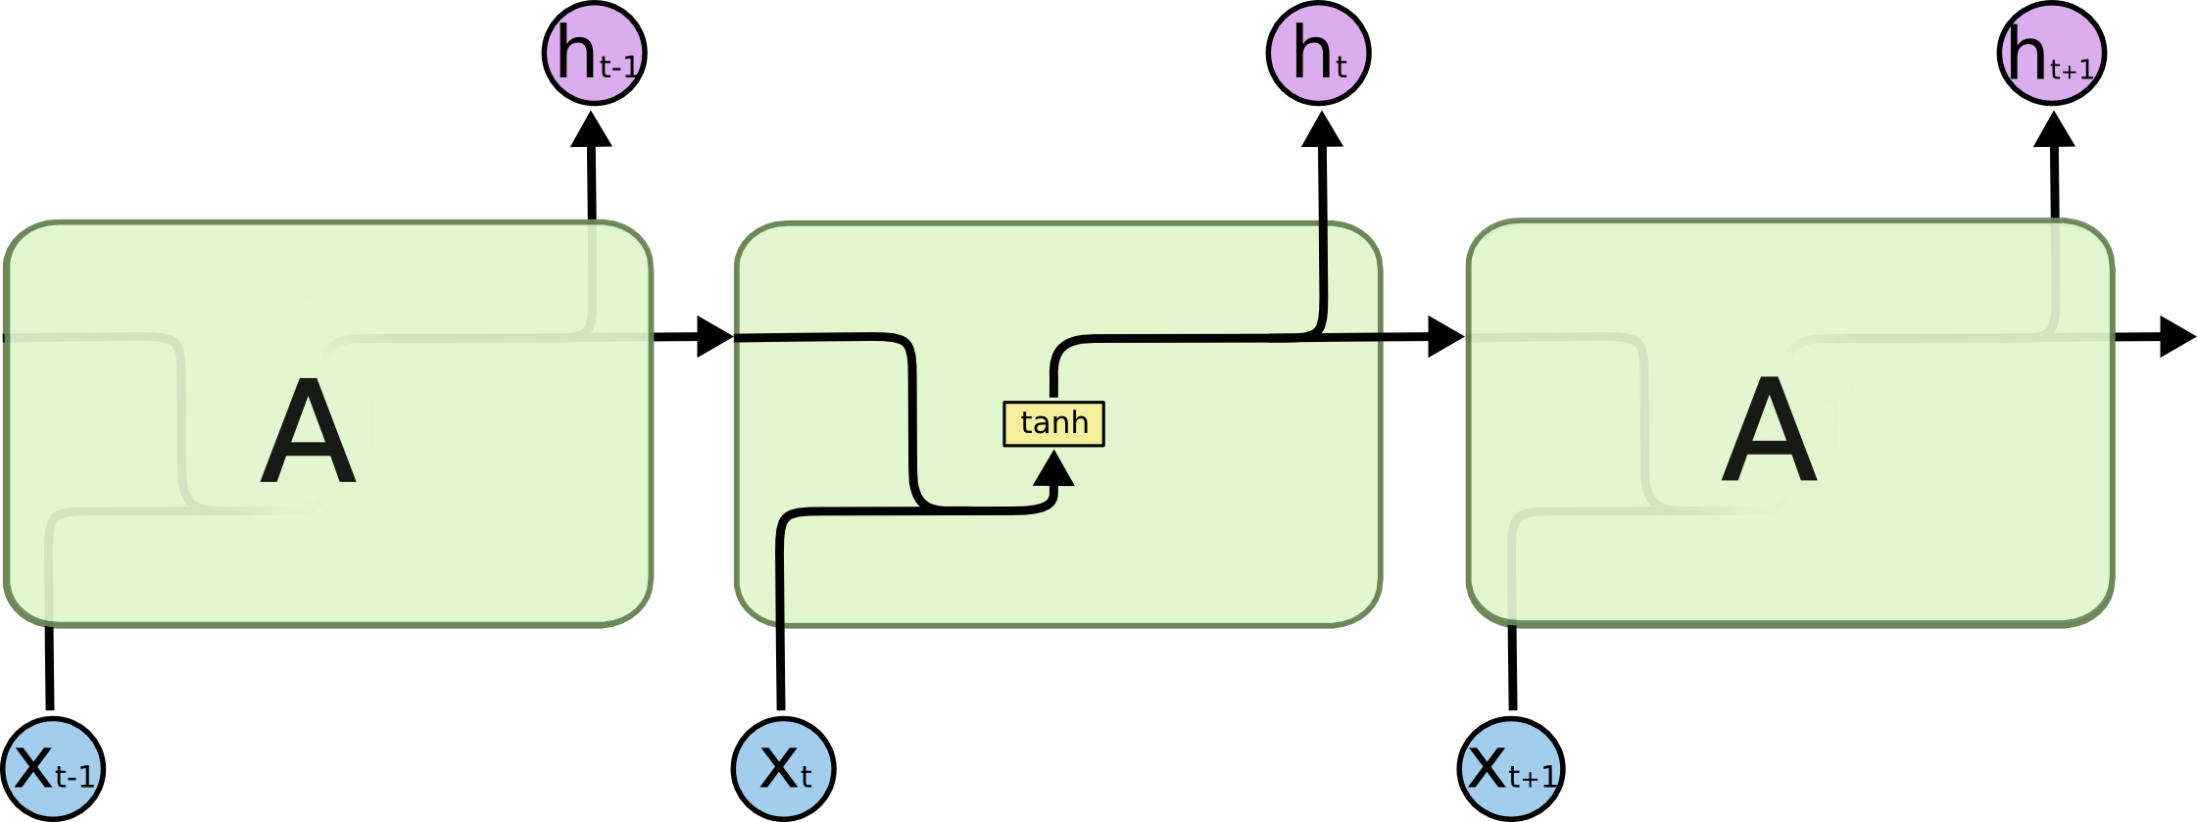
RNN

Slide 4

基本LSTM

Slide 5
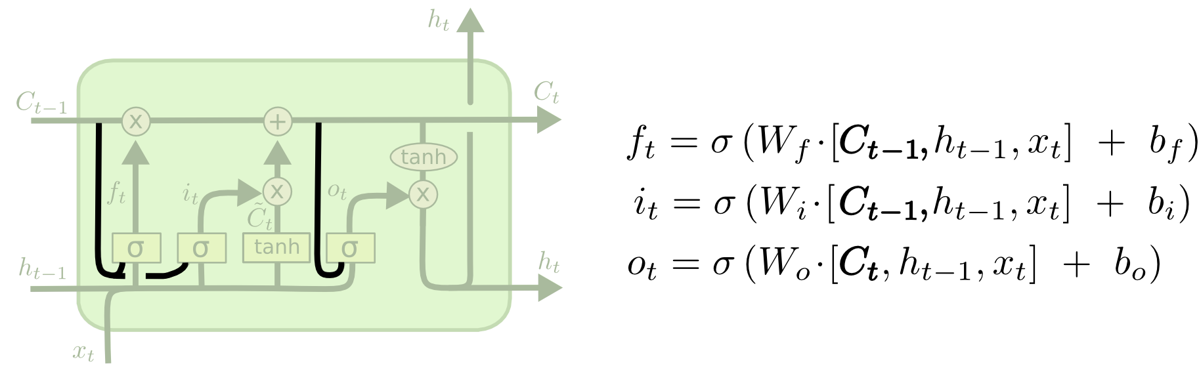
peephole connections

Slide 6
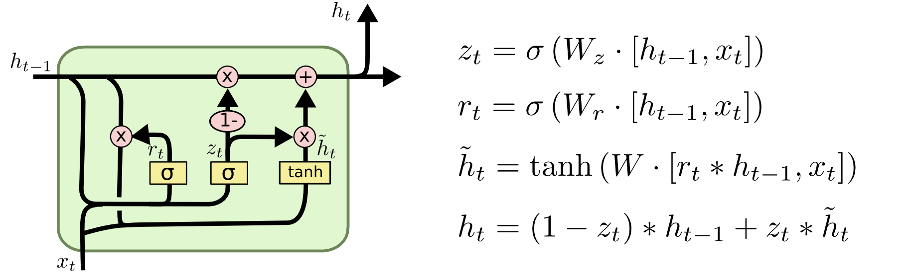
Gated Recurrent Unit (GRU)
Notes:
而GRU模型如下，它只有两个门了，分别为更新门和重置门，即图中的ztzt和rtrt。更新门用于控制前一时刻的状态信息被带入到当前状态中的程度，更新门的值越大说明前一时刻的状态信息带入越多。重置门用于控制忽略前一时刻的状态信息的程度，重置门的值越小说明忽略得越多。

Slide 7
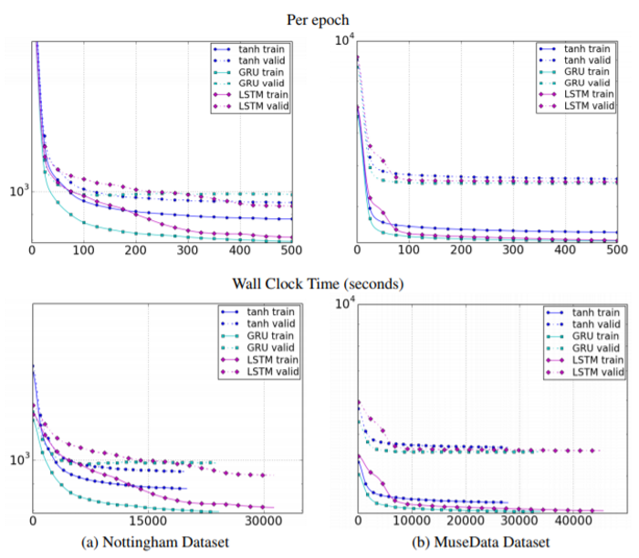
LSTM & GRU 比較
Empirical Evaluation of Gated Recurrent Neural Networks on Sequence Modeling

Slide 8
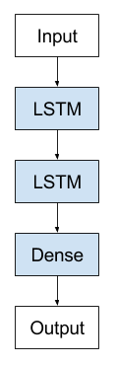
Why Increase Depth?
The additional hidden layers are understood to recombine the learned representation from prior layers and create new representations at high levels of abstraction.
Increasing the depth of the network provides an alternate solution that requires fewer neurons and trains faster.

Slide 9
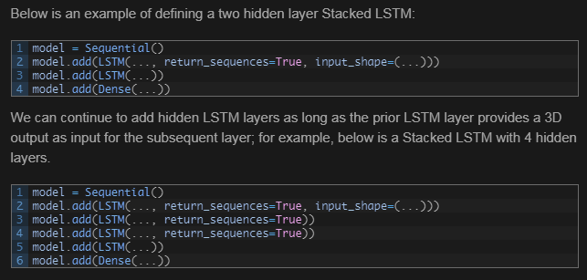
Example

Slide 10
參考資料
Understanding LSTM Networks
GRU神经网络
Stacked Long Short-Term Memory Networks

